Slide 1
Macro Processors
UNIT III
Chapter 5

Slide 2
Introduction
Concept
A macro instruction is a notational convenience for the programmer
It allows the programmer to write shorthand version of a program (module programming)
The macro processor replaces each macro invocation with the corresponding sequence of statements (expanding)

Slide 3
Macro Processor
Recognize macro definitions
Save the macro definition
Recognize macro calls
Expand macro calls
Source Code
(with macro)
Macro Processor
Expanded Code
Compiler or Assembler
obj

Slide 4
Macro Definition
copy code
parameter substitution
conditional macro expansion
macro instruction defining macros

Slide 5
Copy code -- Example
Source
STRG MACRO
STA DATA1
STB DATA2
STX DATA3
MEND
.
STRG
.
STRG
.
.
Expanded source
.
.
.
STA DATA1
STB DATA2
STX DATA3
.
STA DATA1
STB DATA2
STX DATA3
.
{
{

Slide 6
Macro vs. Subroutine
Macro
the statement of expansion are generated each time the macro are invoked
Subroutine
the statement in a subroutine appears only once

Slide 7
Parameter Substitution -- Example
Source
STRG MACRO &a1, &a2, &a3
STA &a1
STB &a2
STX &a3
MEND
.
STRG DATA1, DATA2, DATA3
.
STRG DATA4, DATA5, DATA6
.
.
Expanded souce
.
.
.
STA DATA1
STB DATA2
STX DATA3
.
STA DATA4
STB DATA5
STX DATA6
.
{
{

Slide 8
Macro Definition and Expansion
Fig. 4.1 shows an example of a SIC/XE program using macro instructions.
RDBUFF and WRBUFF
MACRO and MEND
RDBUFF is name
Parameters of the macro instruction, each parameter begins with the character &.
Macro invocation statement and the arguments to be used in expanding the macro.
Fig. 4.2 shows the output that would be generated.

Slide 15
Macro Processor Algorithm and Data Structures
Two-pass macro processor
All macro definitions are processed during the first pass.
All macro invocation statements are expanded during the second pass.
Two-pass macro processor would not allow the body of one macro instruction to contain definitions of other macros.
Such definitions of macros by other macros Fig. 4.3

Slide 16
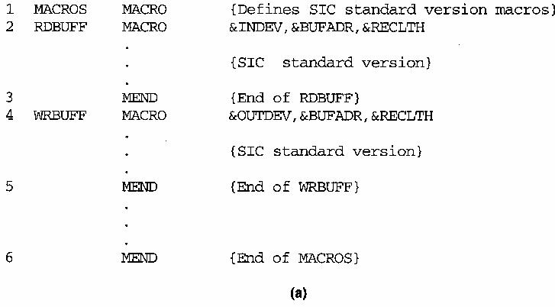
Macro processor algorithm and data structures
Macro definition within macros
process macro definition during expansion time
Example 4.3(nested macro definition)

Slide 17
A one-pass macro processor that can alternate between macro definition and macro expansion.
The definition of a macro must appear in the source program before any statements that invoke that macro.
Inconvenience of the programmer.
Macro definitions are stored in DEFTAB
Comment lines are not entered the DEFTAB.

Slide 18
The macro names are entered into NAMTAB, NAMTAB contains two pointers to the beginning and the end of the definition in DEFTAB
The third data structure is an argument table ARGTAB, which is used during the expansion of macro invocations.
The arguments are stored in ARGTAB according to their position in the argument list.

Slide 19
Fig. 4.4 shows positions of the contents of these tables during the processing.
Parameter &INDEV -> Argument ?1
Parameter &BUFADR -> Argument ?2
When the ?n notation is recognized in a line form DEFTAB, a simple indexing operation supplies the proper argument form ARGTAB.

Slide 20
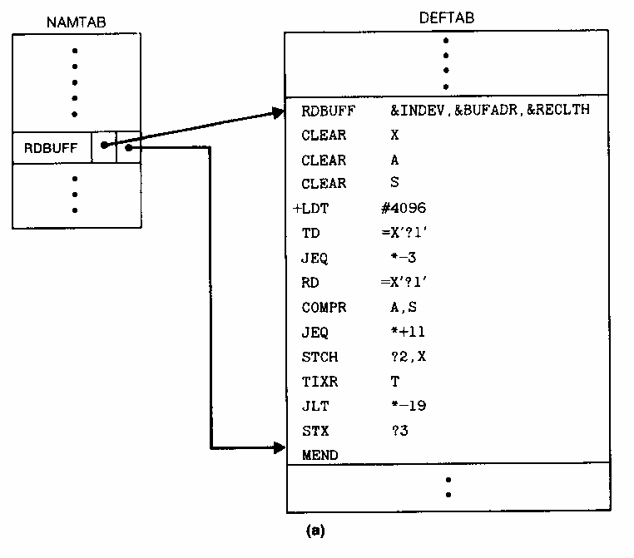
One-Pass Macro Processor Data Structures -- Global Variables
DEFTAB
NAMTAB
ARGTAB
EXPANDING

Slide 21
One-Pass Macro Processor
Prerequisite
every macro must be defined before it is called
Sub-procedures
macro definition: DEFINE
macro invocation: EXPAND
NAMTAB
MACRO
DEFINE
DEFTAB
PROCESSLINE
ARGTAB
CALL
EXPAND

Slide 22
The macro processor algorithm itself is presented in Fig. 4.5.
The procedure PROCESSING
The procedure DEFINE
Called when the beginning of a macro definition is recognized, makes the appropriate entries in DEFTAB and NAMTAB.
The procedure EXPAND
Called to set up the argument values in ARGTAB and expand a macro invocation statement.
The procedure GETLINE
Called at several points in the algorithm, gets the next line to be processed.
EXPANDING is set to TRUE or FALSE.

Slide 23
To solve the problem is Fig. 4.3, our DEFINE procedure maintains a counter named LEVEL.
MACRO directive is read, the value of LEVEL is inc. by 1.
MEND directive is read, the value of LEVEL is dec. by 1.

Slide 24
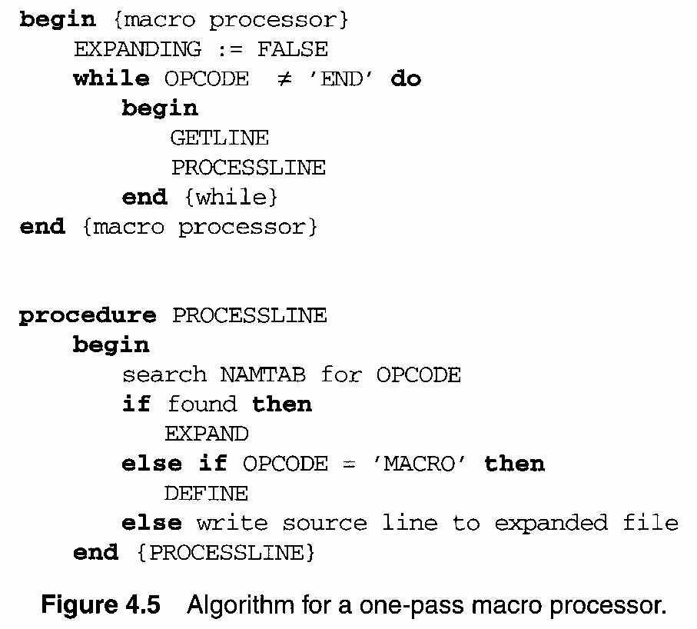

Slide 25
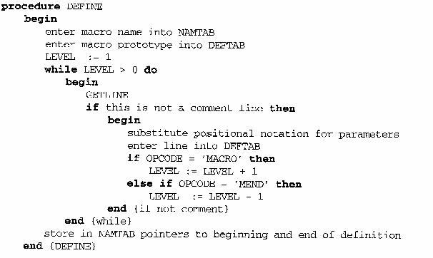

Slide 26
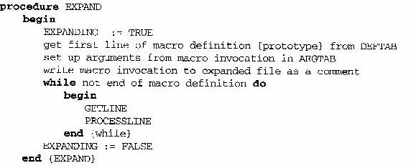
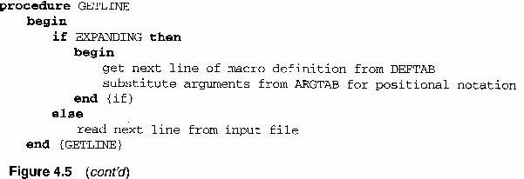

Slide 27
One-Pass Macro Processor That Allows Nested Macro Definition
Sub-procedures
macro definition: DEFINE
macro invocation: EXPAND
EXPAND may invoke DEFINE when encounter macro definition
NAMTAB
DEFINE
MACRO
DEFTAB
PROCESSLINE
CALL
EXPAND
ARGTAB
Expanding
MACRO Definition

Slide 28
1-Pass Macro Processor

Slide 29
Comparison of Macro Processors Design
Single pass
every macro must be defined before it is called
one-pass processor can alternate between macro definition and macro expansion
nested macro definitions may be allowed but nested calls are not
Two pass algorithm
Pass1: Recognize macro definitions
Pass2: Recognize macro calls
nested macro definitions are not allowed

Slide 30
Machine Independent Macro Processor Features
Concatenation of Macro Parameters
Generation of Unique Labels
Conditional Macro Expansion
Keyword Macro parameters

Slide 31
Most macro processors allow parameters to be concatenated with other character strings.
A program contains one series of variables named by the symbols XA1, XA2, XA3, …, another series named by XB1, XB2, XB3, …, etc.
The body of the macro definition might contain a statement like
SUM Macro &ID
LDA X&ID1
LDA X&ID2
LDA X&ID3
LDA X&IDS

Slide 32
The beginning of the macro parameter is identified by the starting symbol &; however, the end of the parameter is not marked.
The problem is that the end of the parameter is not marked. Thus X&ID1 may mean “X” + ID + “1” or “X” + ID1.
In which the parameter &ID is concatenated after the character string X and before the character string 1.

Slide 33
Most macro processors deal with this problem by providing a special concatenation operator (Fig. 4.6).
In SIC or SIC/XE, -> is used

Slide 34
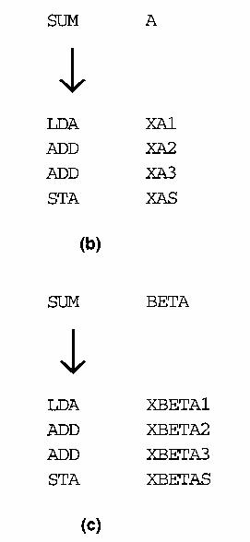
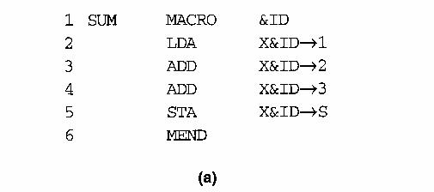
Concatenation of Macro Parameters
Pre-concatenation
LDA X&ID1
Post-concatenation
LDA X&ID→1
Example: Figure 4.6

Slide 35
Generation of Unique Labels
As we discussed in Section 4.1, it is in general not possible for the body of a macro instruction to contain labels of usual kind.
WRBUFF (line 135) is called twice.
Fig. 4.7 illustrates one techniques for generating unique labels within a macro expansion.
Labels used within the macro body begin with the special character $.
Each symbol beginning with $ has been modified by replacing $ with $AA.

Slide 36
Generation of Unique Labels

Slide 37
Generation of Unique Labels
Example
JEQ *-3
inconvenient, error-prone, difficult to read
Example Figure 4.7
$LOOP TD =X’&INDEV’
1st call:
$AALOOP TD =X’F1’
2nd call:
$ABLOOP TD =X’F1’

Slide 38
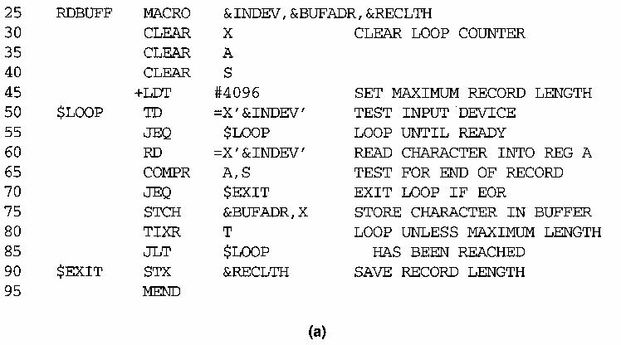

Slide 39
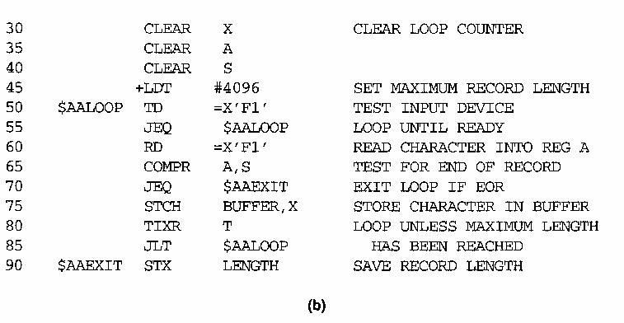
RDBUFF F1, BUFFER, LENGTH

Slide 40
Conditional Macro Expansion
The use of one type of conditional macro expansion statement is illustrated in Fig. 4.8.
The definition of RDBUFF has two additional parameters: &EOR and &MAXLTH.
Macro processor directive SET
This SET statement assigns the value 1 to &EORCK.
The symbol &EORCK is a macro time variables, which can be used to store working values during the macro expansion.
RDBUFF F3,BUF,RECL,04,2048
RDBUFF 0E,BUFFER,LENGTH,,80
RDBUFF F1,BUFF,RLENG,04

Slide 45
Conditional Macro Expansion
A different type of conditional macro expansion statement is illustrated in Fig. 4.9.
There is a list (00, 03, 04) corresponding to &EOR.
%NITEMS is a macro processor function that returns as its value the number of members in an argument list.
%NITEMS(&EOR) is equal to 3.
&CTR is used to count the number of times the lines following the WHILE statement have been generated.
Thus on the first iteration the expression &EOR[&CTR] on line 65 has the value 00 &EOR[1]; on the second iteration it has the value 03, and so on.
How to implement nesting WHILE structures?

Slide 48
Keyword Macro Parameters
Positional parameters
Parameters and arguments were associated with each other according to their positions in the macro prototype and the macro invocation statements.
A certain macro instruction GENER has 10 possible parameters.
GENER MACRO &1, &2, &type, …, &channel, &10
GENER , , DIRECT, , , , , , 3

Slide 49
Keyword Macro Parameters
Keyword parameters
Each argument value is written with a keyword that names the corresponding parameter.
Arguments may appear in any order.
GENER TYPE=DIRECT, CHANNEL=3
parameter=argument
Fig. 4.10 shows a version of the RDBUFF using keyword.

Slide 53
END OF CHAPTER 05

